Slide 1


Slide 2

Week 1 - Introductions
Data Science as a field is an intersection between mathematics, computer science, and domain expertise
There are 4 types of Analytics:
Descriptive – describes what has happened
Diagnostics – focuses on why it happened
Predictive – what is most likely going to happen soon
Prescriptive - suggests a course of action
Data Science = building > ML = Learning > AI = Practice
Statistics focuses on data assumptions; feature meaning is significant, model fitting is performed, parametric form
ML focuses on predictions, features don’t mean much as long as accuracy is high, model training and validation is performed, non-parametric forms mostly
Big Data Analytics only differ in data management and storage, analytics is same
Python is used for ML, R is suitable for statistics
w3school for learning python
Statquest for in-depth theory

Slide 3
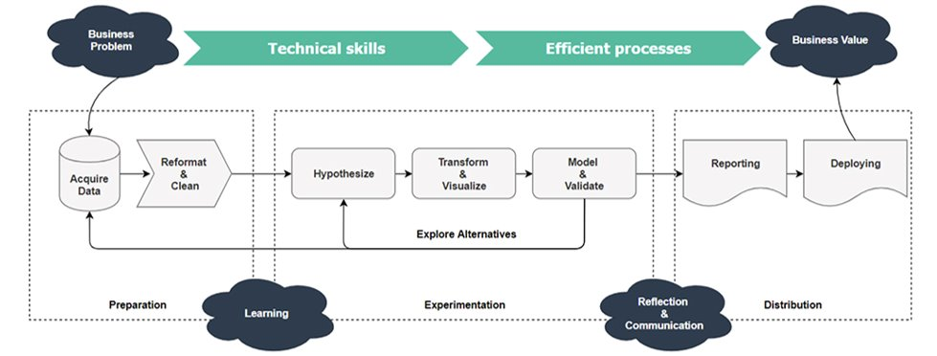

Data Science Workflow

Slide 4


Week 2 – Collecting & Exploring Data
4 types of data collection
Cross-sectional >> widely used in regression and classification problems
Time-Series >> widely used in forecasting based on historical data
Panel data >> cross-sectional data defined by regular time index
Pooled data >> irregular multi-period data, often with an event in between
Probability Sampling
Simple Random
Stratified
Systematic
Clustered
Non-probability Sampling
Convenience
Purposive
Snowball
Quota

Slide 5








Week 2 – Collecting & Exploring Data
Correlation (r): deals with association of two variables, -1 ≤ r ≤ 1. Correlation is positive, negative, and zero
$Correlation Coefficient= \frac{Cov(x,y)}{\sqrt{Var\left(x\right)}\sqrt{Var(y)}}$
Covariance vs Correlation
Pearson Coefficient : numeric x numeric
Spearman Coefficient: ordinal x numeric
Kendal tau: ordinal x ordinal
Correlation ≠ Causation
Contingency table demonstrate probabilistic relationships between several categorical variable
Line chart is used for plotting time indexed data, scatter demonstrates pattern between 2 variables, bar plots categories against a common numeric value, histogram plots intervals, pie chart plots categorical aggregates.
PandasGUI in Anaconda

Slide 6
Week 3 – Data Manipulation
Different types of Data: Quantitative (Continuous and Discrete) and Qualitative (Nominal and Ordinal)
Variable Types: Dependent and Independent
Combination of two or more variables working together to reflect the change in the dependent variable – Interaction Variable
Feature Engineering: Process of using domain knowledge to extract, transform, create, and scale features.
​Feature Encoding – Label Encoding and One Hot Encoding
Feature Scaling (Standardization & Normalization) - Make sure features are on a similar scale​
Feature Scaling –Process of selecting the most important features to be input in Machine Learning models​ - Feature Selection (Forward & Backward)
Missing Value Treatment: Deletion and Imputation
Pairwise Deletion: Deleting only missing values.
Listwise Deletion: Deleting the row containing missing values
Dropping Entire Columns: Deleting the column containing the missing value

Slide 7
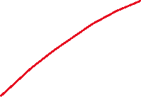

Week 3 – Data Manipulation
Missing Value Treatment: Deletion and Imputation
Mean, Median, Mode (For Non-time series)
Forward fill, Backward fill, and linear interpolation (For time series)
An outlier is a data point that differs significantly from other observations
Outlier Detection: Z-Score, IQR
Outlier Treatment: Trimming / Removing the outlier​, Quantile based flooring and capping​, Mean/Median imputation
​Occurrence of high intercorrelations among two or more independent variables in a multiple regression model​ - Multicollinearity
Correlation Matrix + Heatmap – Detecting Multicollinearity
Redeeming Multicollinearity
Remove statistically redundant variables​
Dimension Reduction Methods​
Regularized Regression or Live with it!​
Heteroskedasticity generally refers to an unequal scattering of data points.​
Redeeming Heteroskedasticity​
Transform Y ​
Weighted Least Square​
Redeem Omitted Variable Bias​

Slide 8





Week 4 – Regression Analysis
Linear Regression fits a straight line through the data.​
Intercept, A Point where Line will Cross y
Slope, How change in X can impact change in Y ​Axis
Gauss Markov Assumption
Linear Relationship
Multicollinearity
Normal Distribution of Residuals
Homoscedasticity
​Optimization is a general term for finding some function’s maximum or minimum.
Estimation is a statistical term for finding some estimate of unknown parameter, given some data.
Gradient Descent Algorithm
OLS / PLS/ GLS / PLS
Summary & Diagnostic of LR model
R2 Squared vs Adjuted R2
P-value
F-Statistics
Notes:
Reducible vs non-reducible errors

Slide 9


Week 4 – Regression Analysis
Underfitting refers to a model that can neither model the training data nor generalizes to new data.
Overfitting refers to a model that models the training data too well.​
Bias refers to the error that is introduced by approximating a real-life problem, which may be extremely complicated, by a much simpler model.
Variance is the variability of model prediction for a given data point or a value which tells us the spread of our data​
Bias-Variance Tradeoff - If our model is too simple and has very few parameters then it may have high bias and low variance. On the other hand, if our model has a large number of parameters then it’s going to have high variance and low bias.
“Regularization” is a way to give a penalty to certain models (usually overly complex ones).​ - Regularized Regression
Ridge Regression and Lasso Regression

Slide 10
Week 5 – GLM and Predictive Modeling
Generalized Linear Model object enables users a flexible generalization of linear regression to fit the response variables via a specialized Link Function.​
There are two components of GLM. ​​
Family Parameter – specifies the Probability Distribution to generate the response variable Y.​​
Link Function – forms a connection between a transformed response variable and the linear combination of independent variables.
Common Family Parameters: Gaussian, Binomial, Poisson, Gamma
Common Link Function: Identity, Log, Logit, Probit, Square Root
OLS is a method for estimating the parameters of a linear regression model. ​
MLE is a more general method that can be used to estimate the parameters of a wide range of statistical models. ​
Poisson Regression (also called Count Regression) fits the model to data with a count response variable.
Logistic Regression is the appropriate regression analysis to conduct when the dependent variable is dichotomous (binary).
Gamma Regression fits the model to a data with a strictly positive response variable and rightly-skewed error distribution. ​
Diagnostic Modeling: Inferences
Predictive Modeling: Predictions

Slide 11
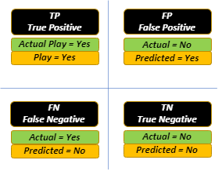
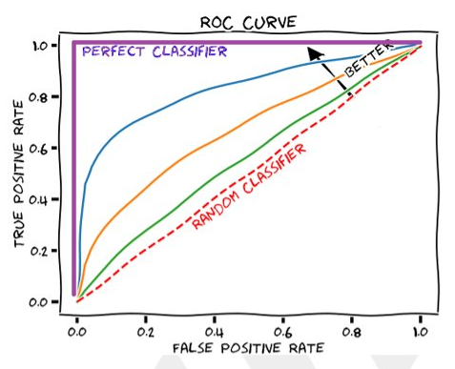
Week 6 – Tree Based ML Algorithms
Decision Tree Algorithms belong to the family of Supervised Learning algorithms.
Decision rules are built based on the Divide and Conquer strategy to corner a particular class from the rest of the data.
Different Elements of DT: Root Node, Terminal Node, Splitting, Pruning, Sub-Tree
​Gini index measures the impurity of a set of samples. It ranges between 0 and 1, where 0 represents a completely pure set and 1 represents a completely impure set.
Information gain is a measure of the difference in entropy between the parent node and the child nodes.
Entropy is a measure of the amount of uncertainty or randomness in a set of samples.
A confusion matrix is a table that is used to define the performance of a classification algorithm.
Accuracy: Number of Times Predictions Were Correct Out of Total
Precision: How Accurately It Predicts Positives
Recall: How Much Positives it Accurately Predicts Out of Total Positives
F Measure: Harmonic Mean of Perfection of Precision & Recall
AUC - ROC curve is a performance measurement for classification problems at various threshold
settings.

Slide 12
















Slide 13
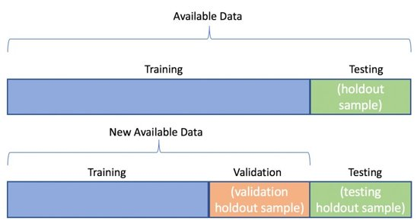
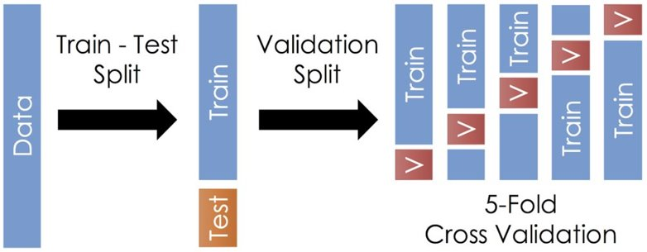
Week 6 – Tree Based ML Algorithms
A large number of relatively uncorrelated models (trees) operating as a committee will outperform any of the individual constituent models.​ - Random Forest
The bootstrap sampling (Bootstrapping) method is a resampling method that uses random sampling with replacement.​
Cross-validation can be used to detect overfitting in a model which infers that the model is not effectively generalizing patterns and similarities in the newly inputted data. ​
There are different types of Cross-Validation techniques​
Hold-out​
K-folds​
In K-fold cross-validation, the dataset is divided into K equal-sized folds.
Hold-out is the simplest form of cross-validation which involves randomly dividing the dataset into two parts: a training set and a validation set.

Slide 14
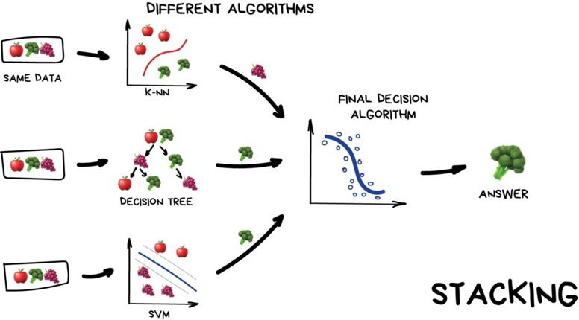
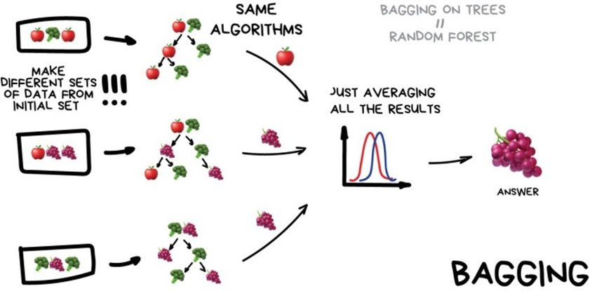
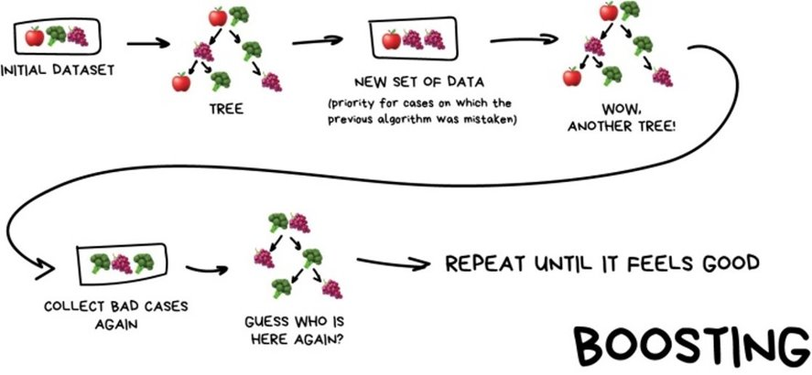
Week 7 – Clustering & Ensemble Methods
Radar Charts are used to compare two or more items or groups on various features or characteristics.
Pie charts are used to represent the proportional data or relative data in a single chart. The concept of pie slices is used to show the percentage of a particular data from the whole pie.
Anomalies are data points that stand out amongst other data points in the dataset and do not confirm the normal behavior in the data.
Anomaly detection is an unsupervised data processing technique to detect anomalies from the dataset.
Anomaly Detection Algorithm: Isolation Forest and Local Outlier Factor
Anomaly Removal:
Trimming
Capping
Treating anomalies as a missing value
Discretization
Ensemble methods are techniques that aim at improving the accuracy of results in models by combining multiple models instead of using a single model.
Types of Ensemble Approach: Bagging, Boosting, and Stacking
Stacking is often referred to as stacked generalization. This technique works by allowing a training algorithm to ensemble several other similar learning algorithm predictions. ​
BAGGing, or Bootstrap AGGregating. BAGGing gets its name because it combines Bootstrapping and Aggregation to form one ensemble model
Boosting is an ensemble technique that learns from previous predictor mistakes to make better predictions in the future. Types: XGBoost, CatBoost, AdaBoost, LightGBM

Slide 15


















Slide 16




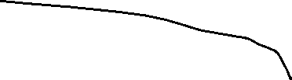






Slide 18
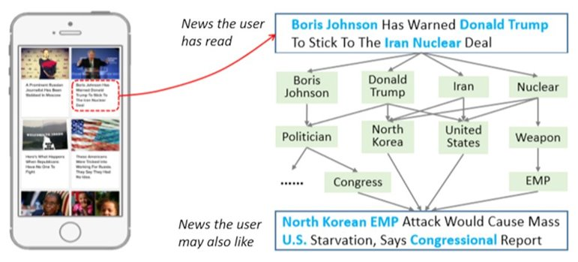
Week 8 – Recommender Systems
Recommender systems aim to predict users' interests and recommend product items that are quite likely interesting to them.
Netflix uses a recommender system to suggest movies and TV shows that a user may want to watch. The algorithm looks at past ratings and preferences to make suggestions.​
Three algorithms used in recommender systems:​
Content-based systems​
Collaborative filtering systems​
Hybrid systems​
Content Based: Estimate rating using this user and this product alone​
Collaborative: Employ information about other users, products too
Hybrid: Combine both content-based and collaborative filtering​

Slide 19

THANK YOU
Training and Certification

